Slide 1


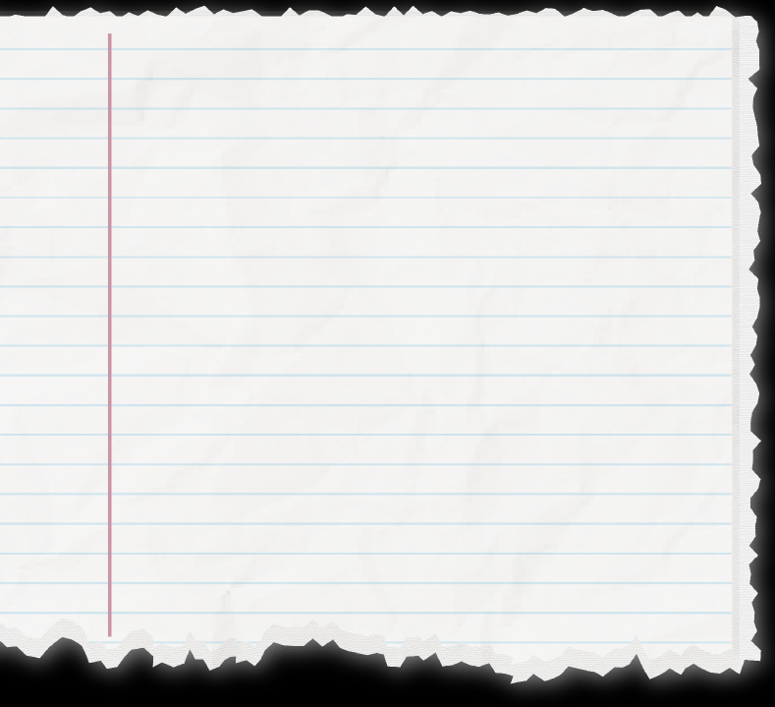
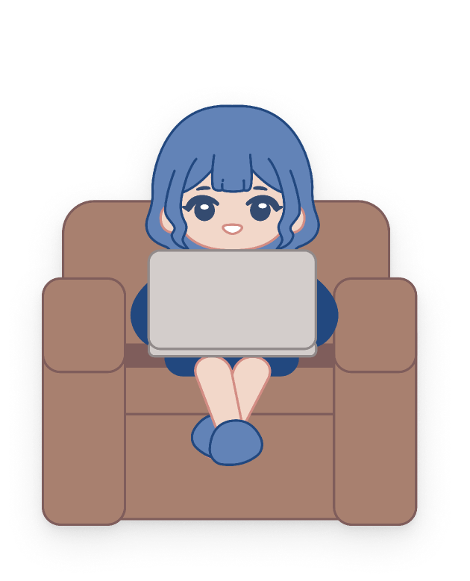


Got a great
story idea!

Slide 2


Writer’s block?
Procrastination?
But trouble finishing it...

Slide 3
Got a great
story idea!

Slide 4



Link the World Through InK
Writer’s block?
Procrastination?
Search by title or username...
Sort by:

Slide 5

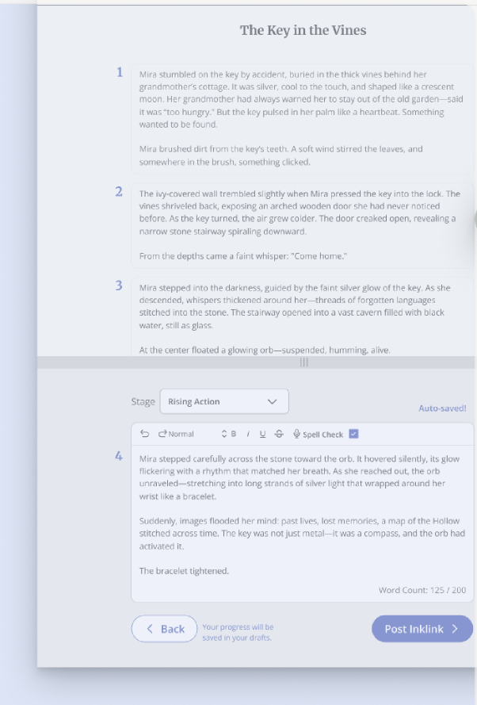
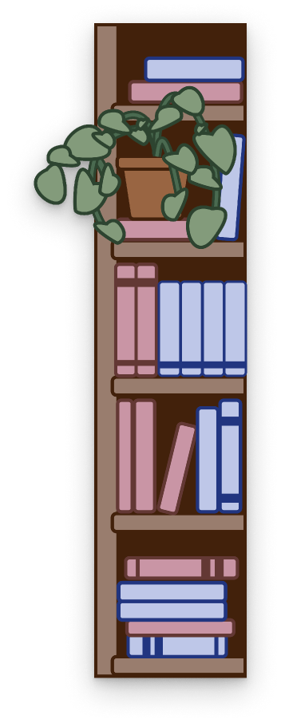










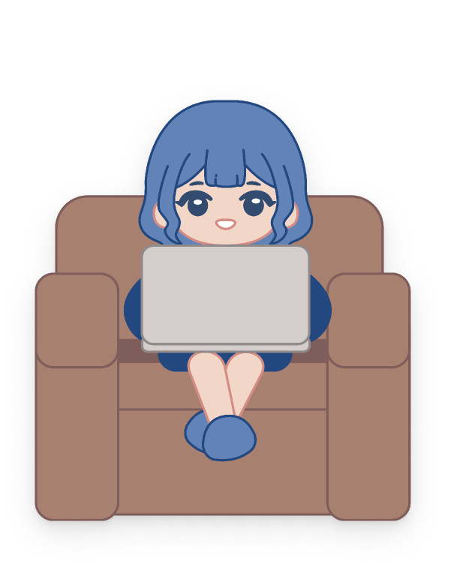

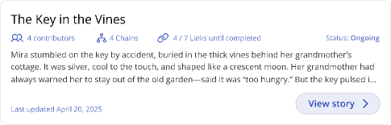
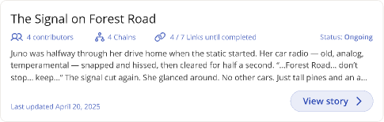



Writer’s block?
Procrastination?
Link the World Through InK
Search by title or username...
Sort by:
Search by title or username...
Sort by:
The Key in the Vines

Slide 6






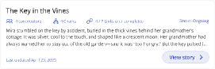
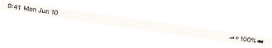
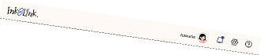
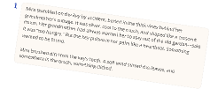
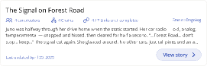
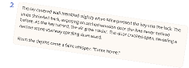
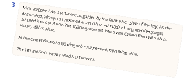
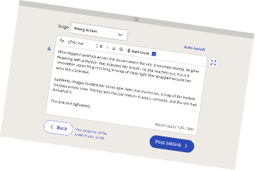


Search by title or username...
Sort by:
The Key in the Vines
Search by title or username...
Sort by:

Slide 7










Search by title or username...
Sort by:
The Key in the Vines

Slide 8




Feature 1:
Search by title or username...
Sort by:
Public Projects
The Key in the Vines
Feature 2:
Private Projects
Search by title or username...
Sort by:

Slide 9




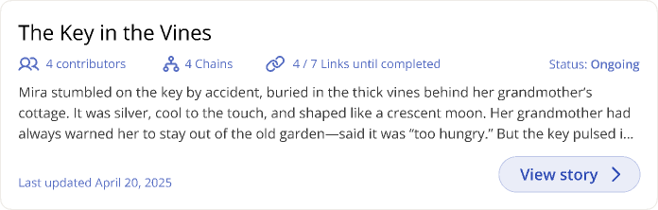
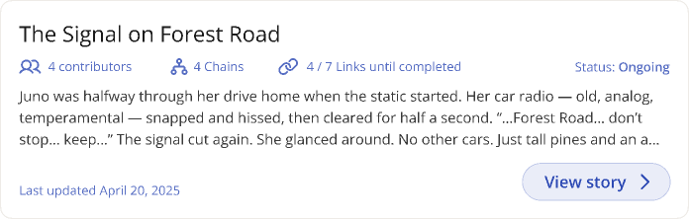
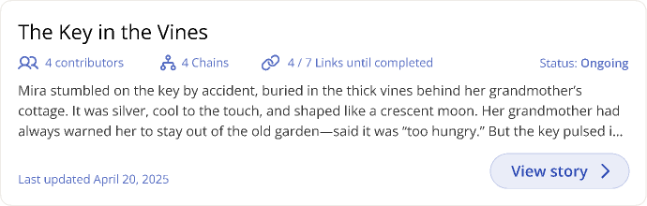
Inklink Features:
Search by title or username...
Sort by:
Public Projects

Slide 10


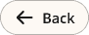

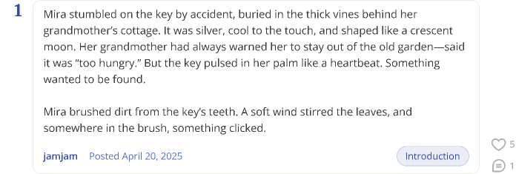



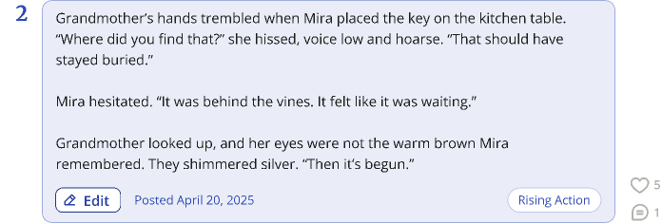
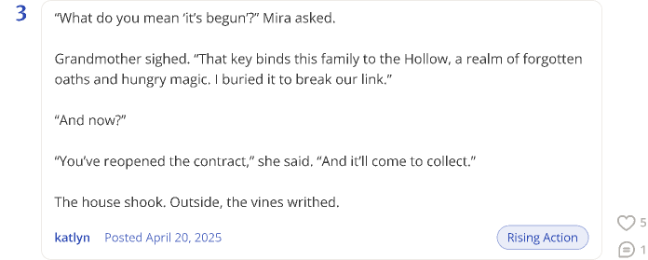
Back
The Key in the Vines
This story has multiple chains
5 contributors
Tap to switch to a different chain
Status: Ongoing
4 Chains
Chain Map
Inklink Features:
Drag to move map
Chain Map
Public Projects
jamjam
leanna
luwucie
jamjam
ubean
katlyn
leanna
Switch
Switch
katlyn
Switch
4 more links until Conclusion...

Slide 11


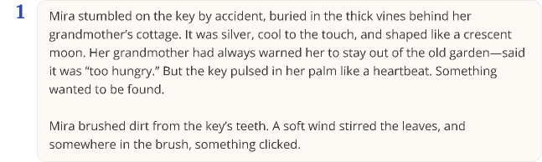
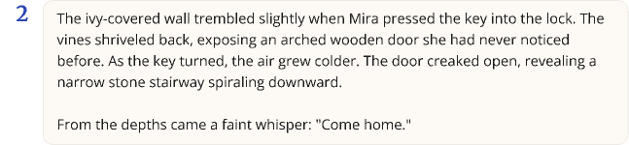
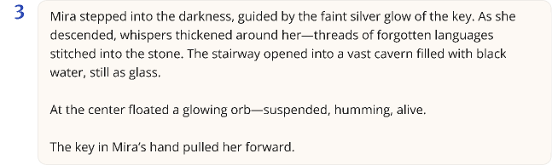
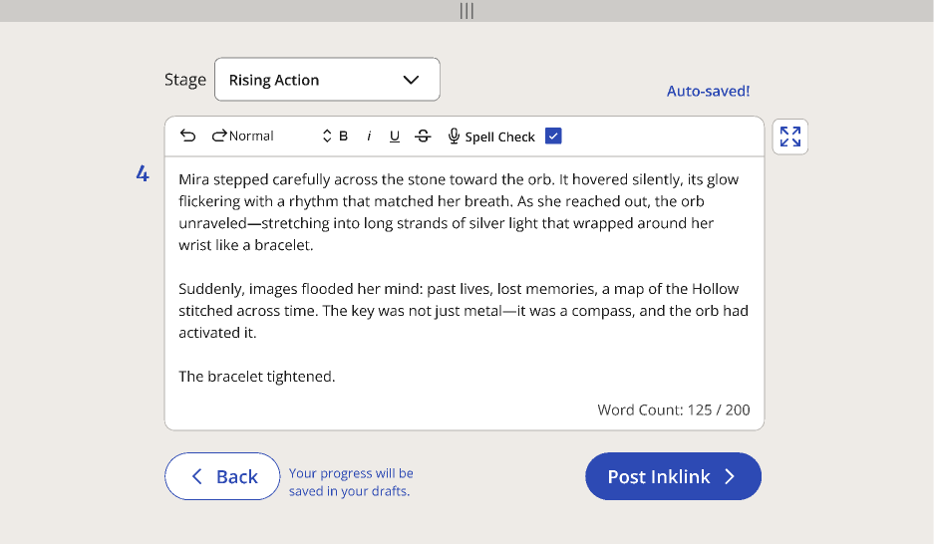
The Key in the Vines
Inklink Features:
Public Projects

Slide 12
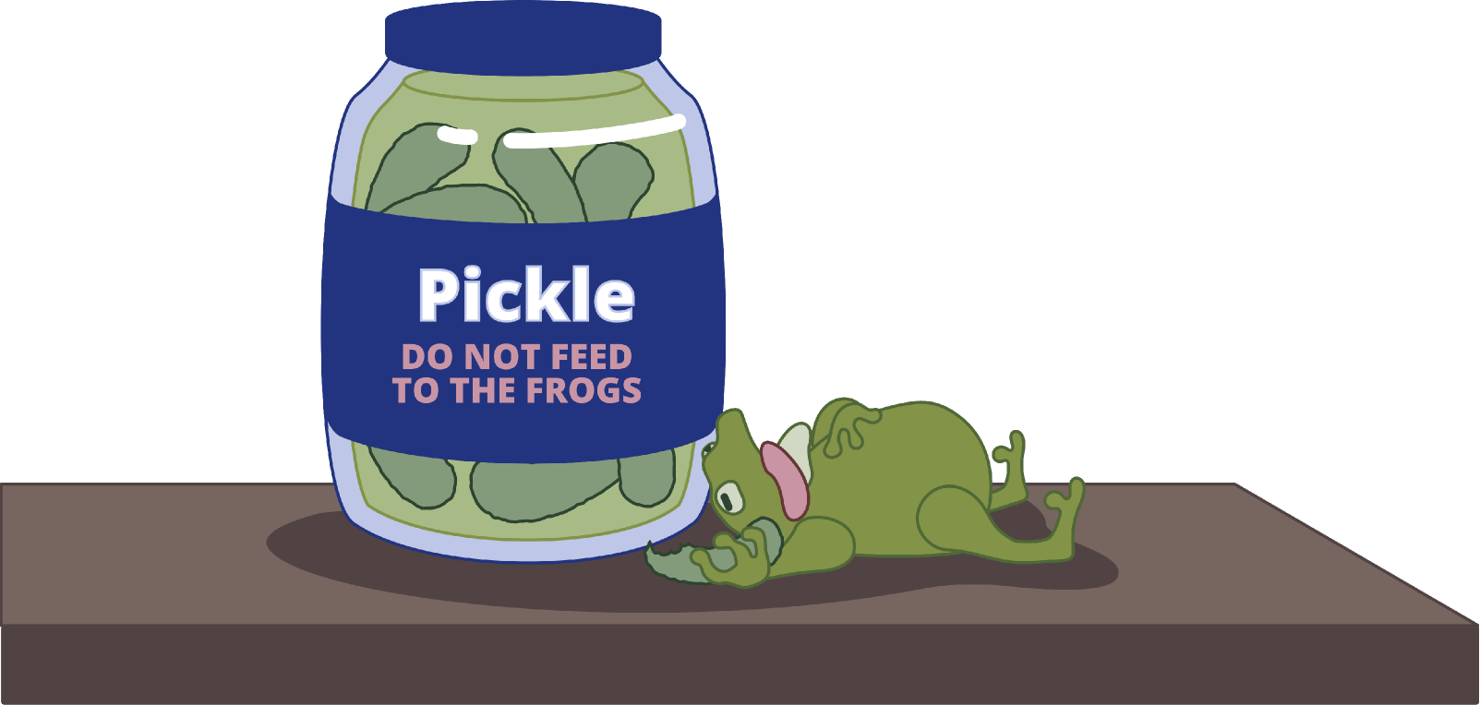

Inklink Features:
Chain-Writing
The Key in the Vines

Slide 13
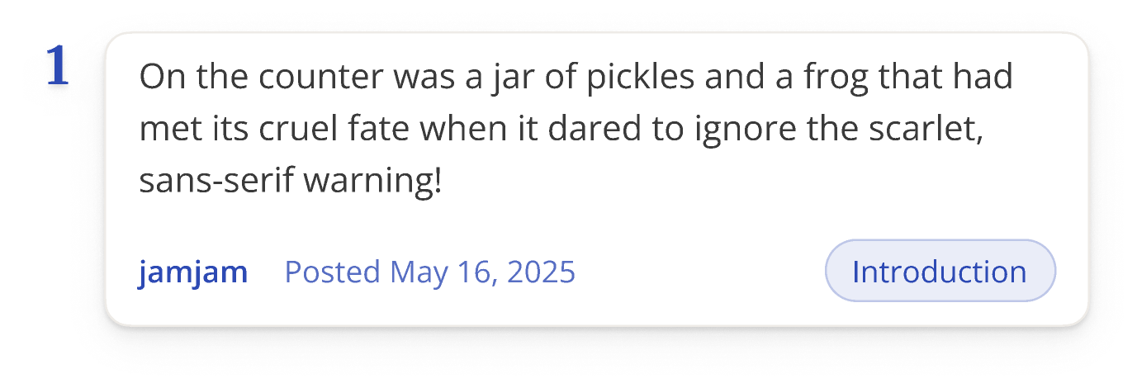


Inklink Features:
Chain-Writing

Slide 14
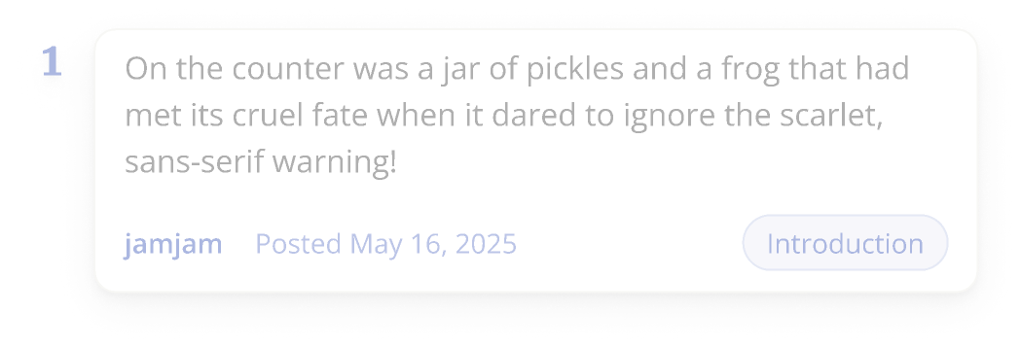
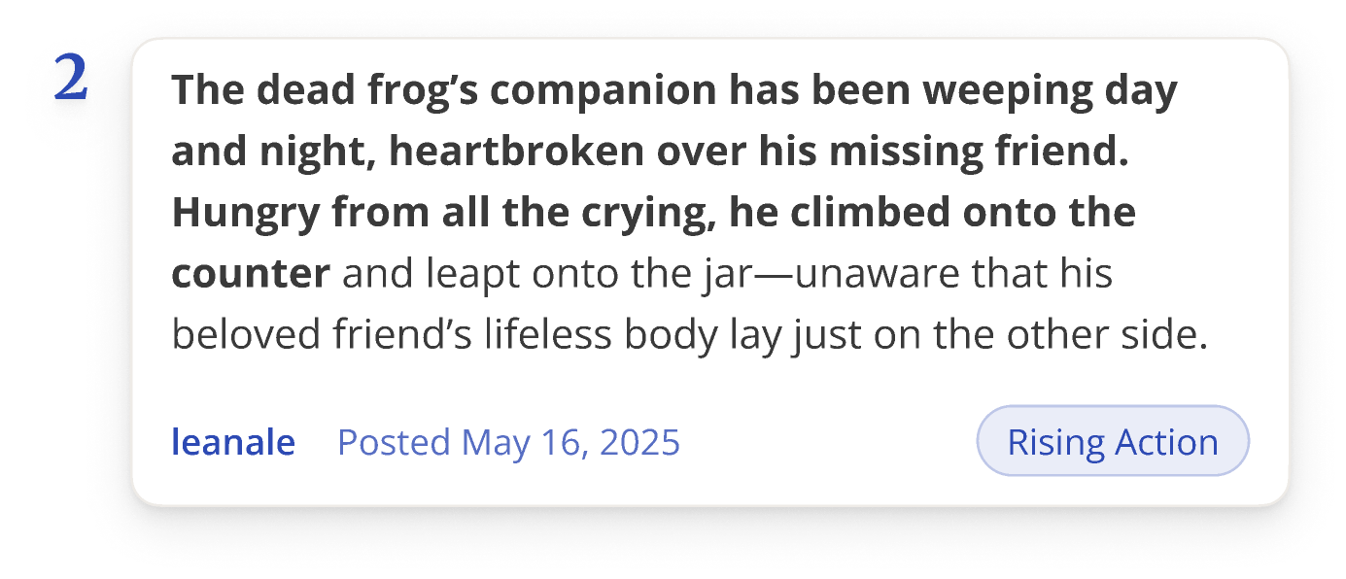


Slide 15

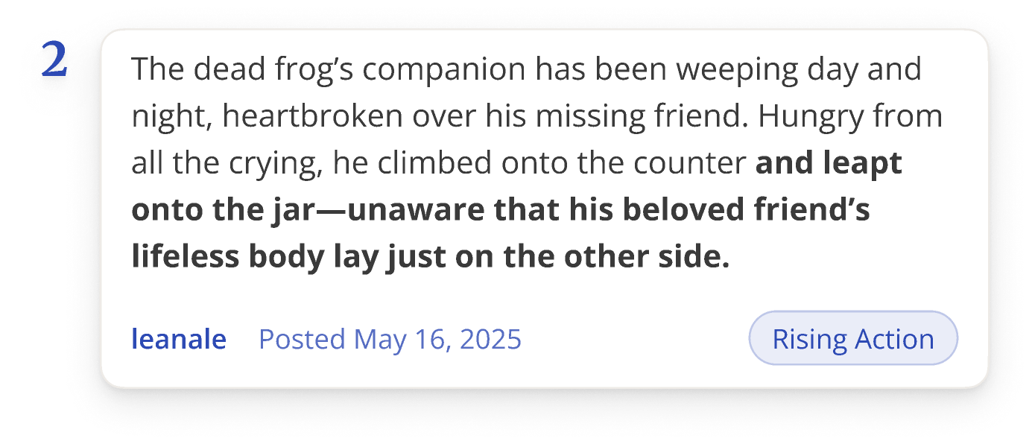
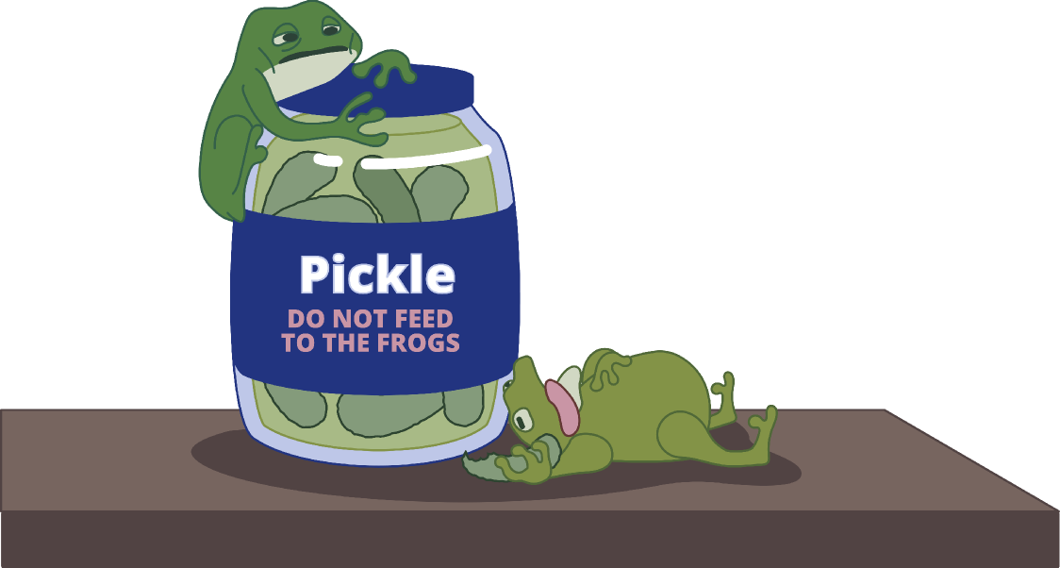

Slide 16

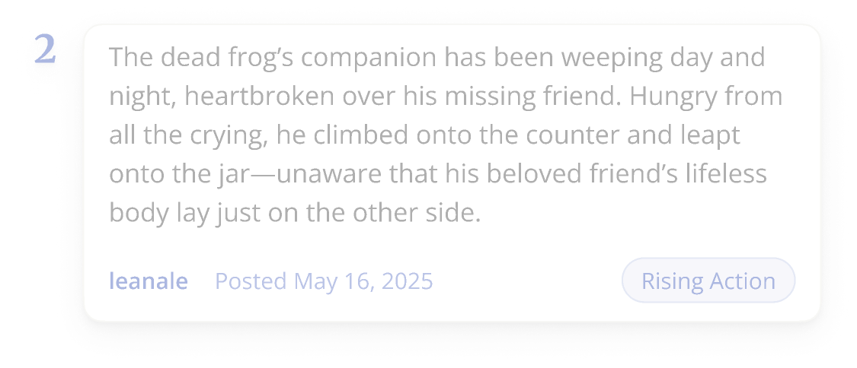
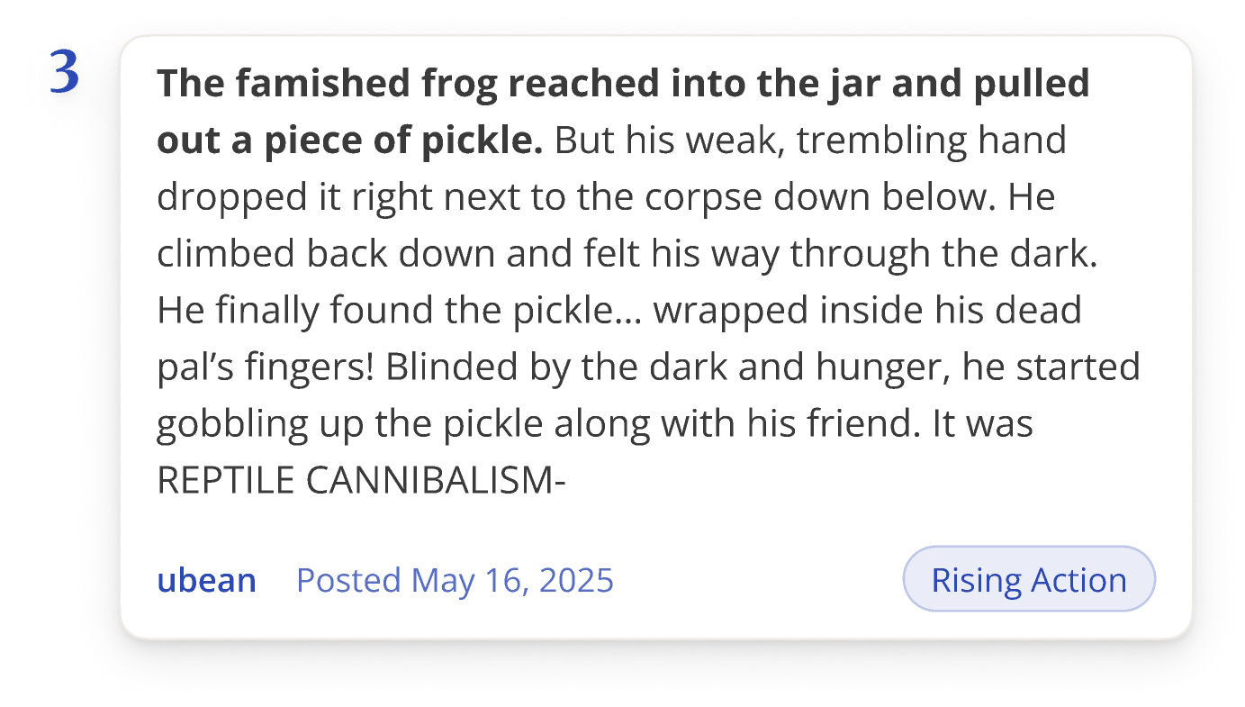
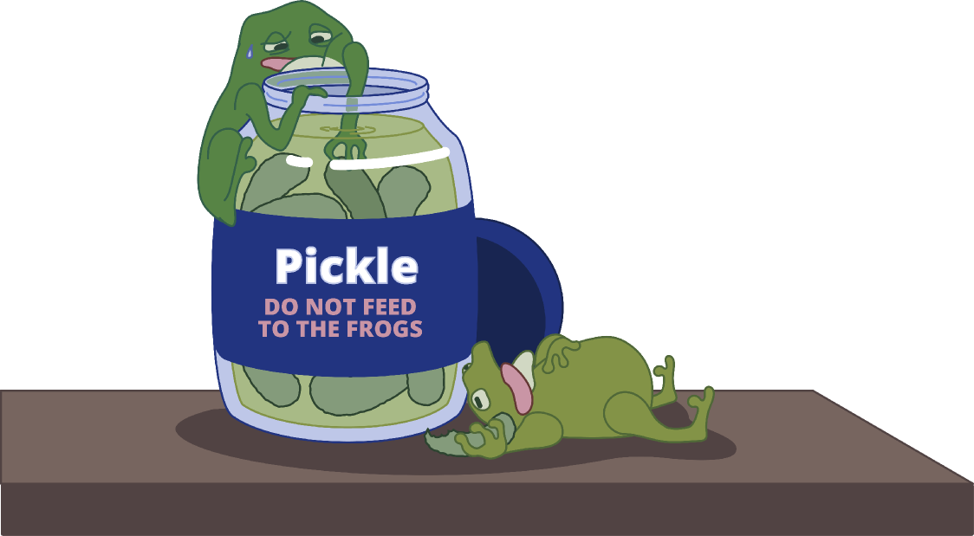

Slide 17

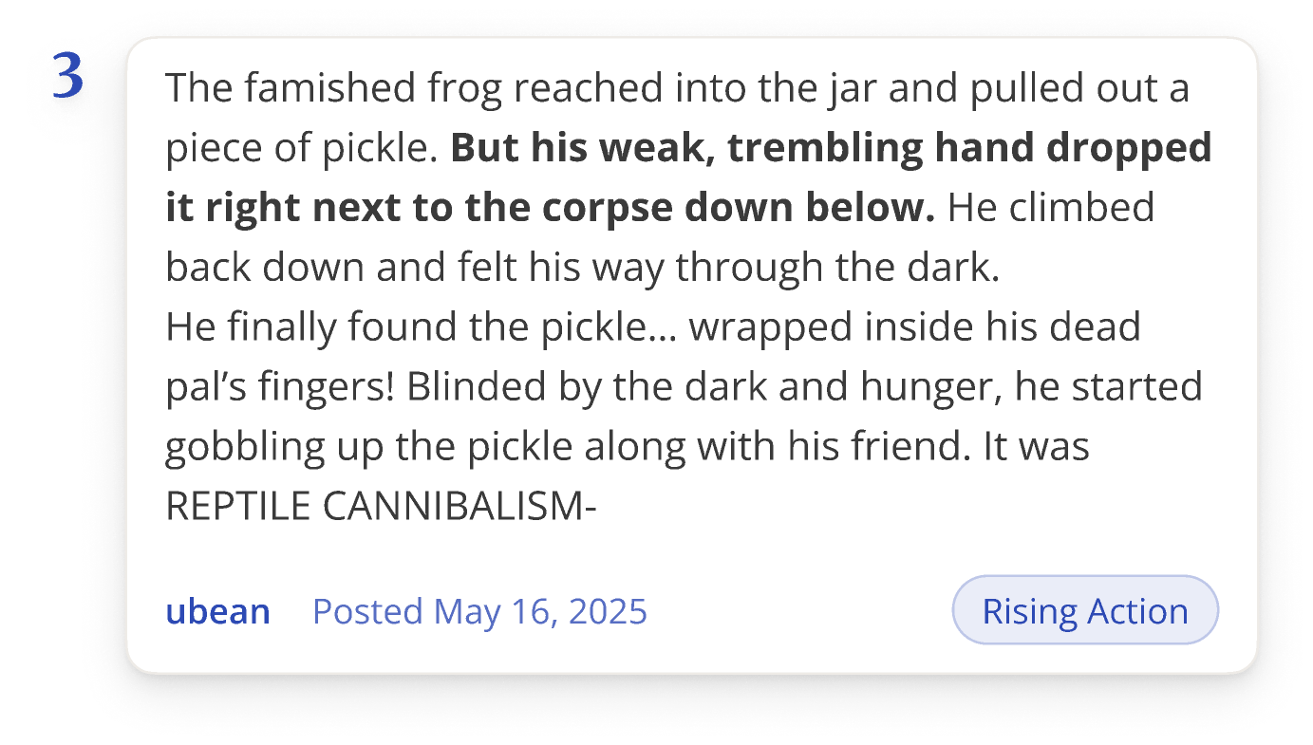
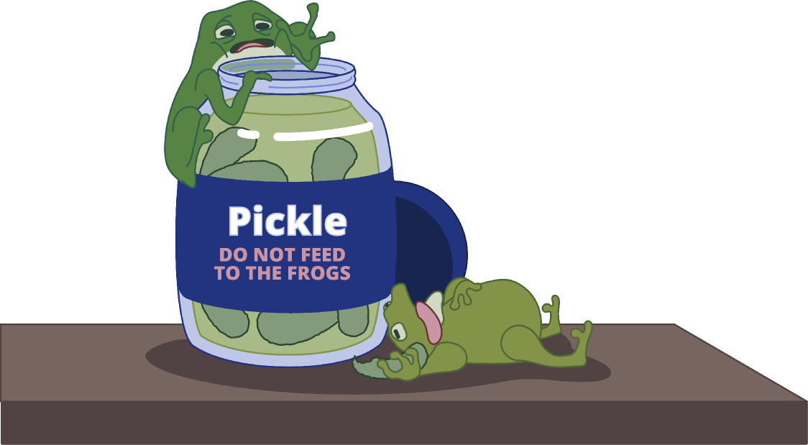


Slide 18

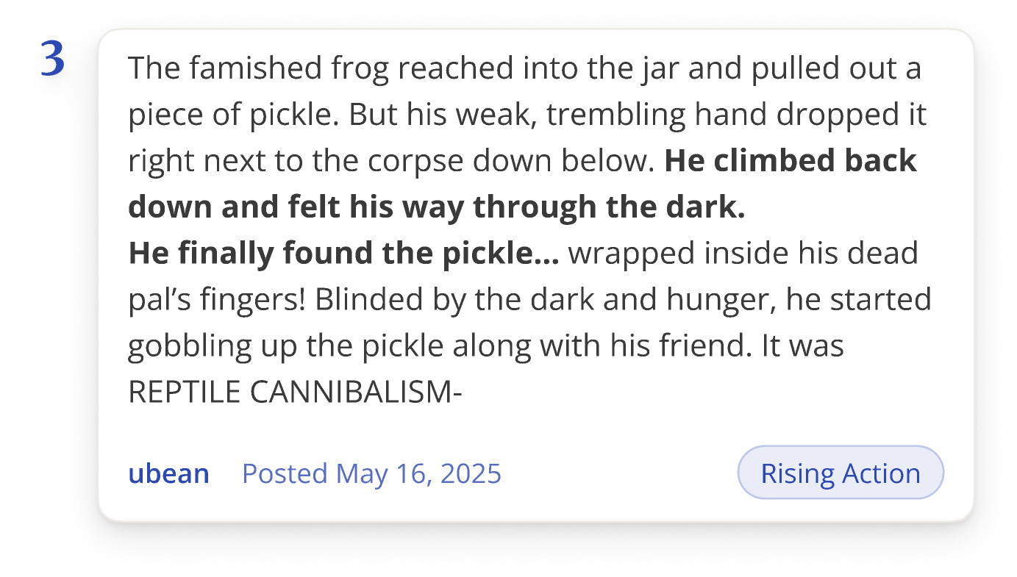
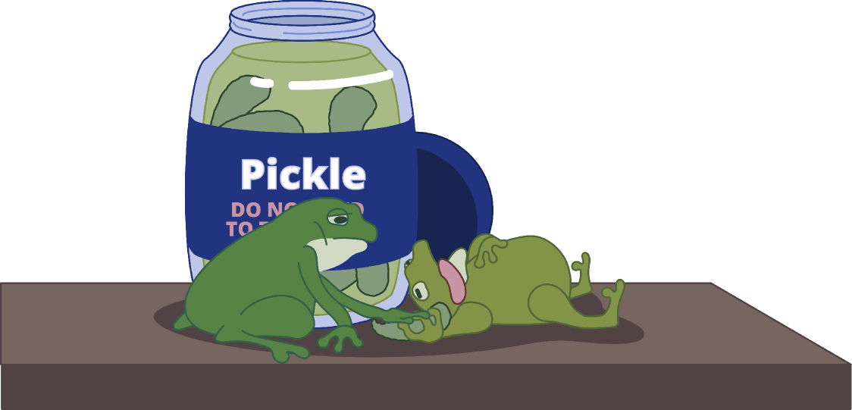

Slide 19

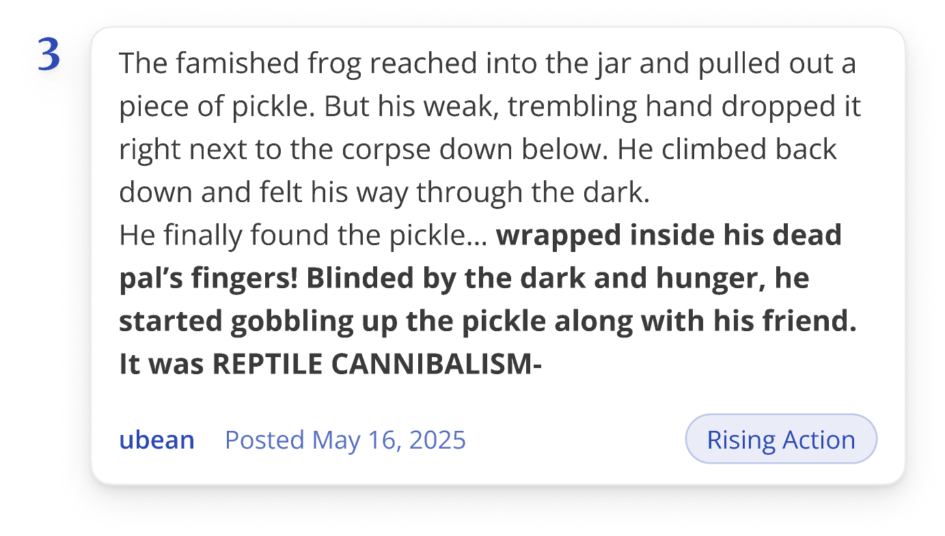
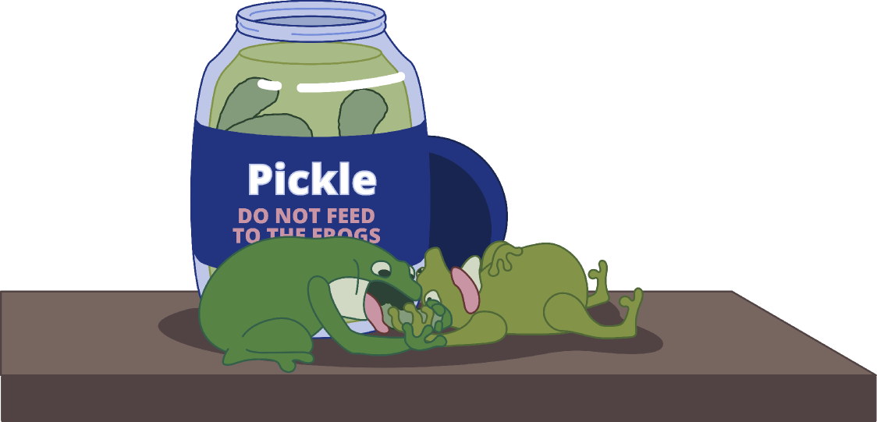


Slide 20


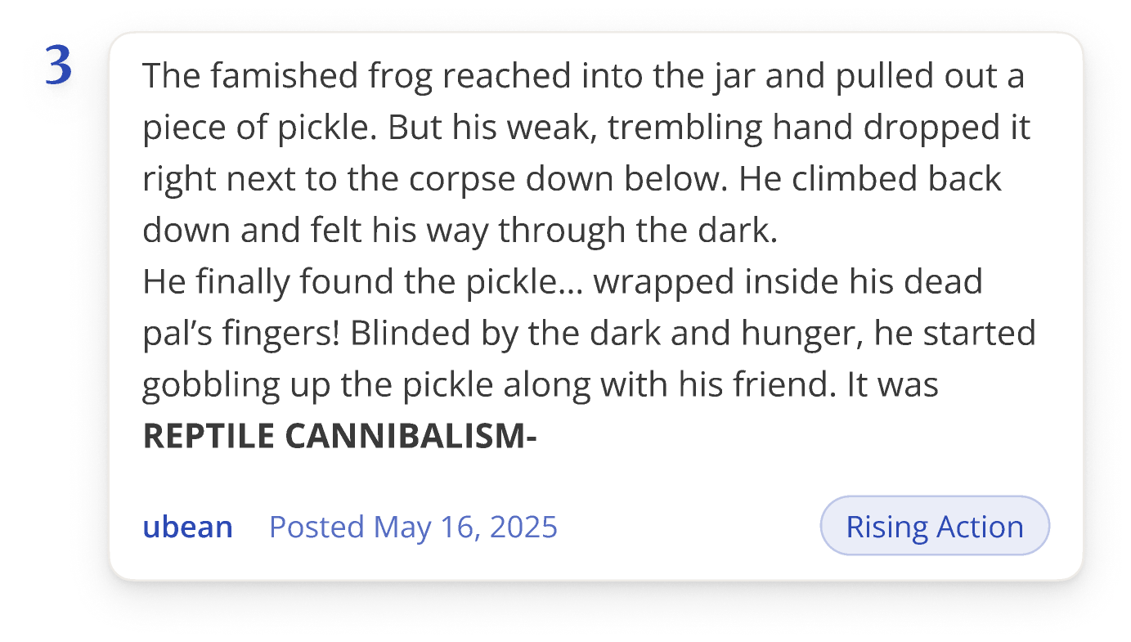
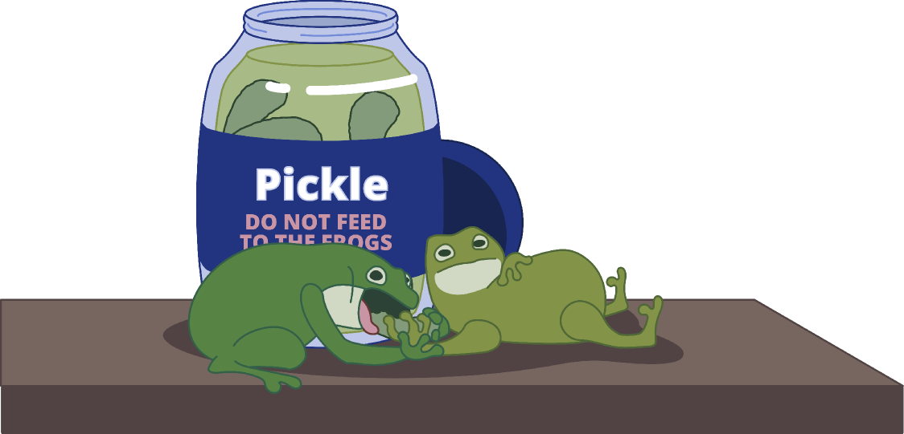

Slide 21

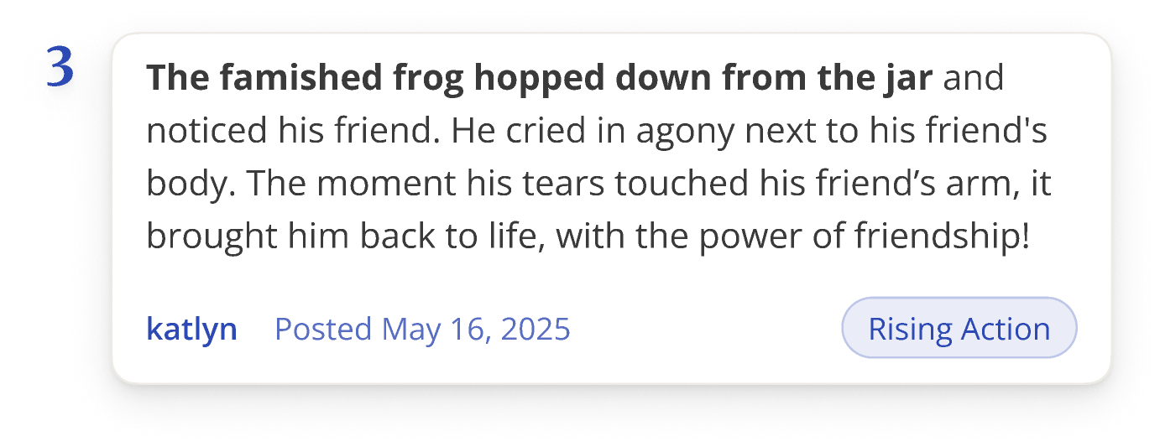
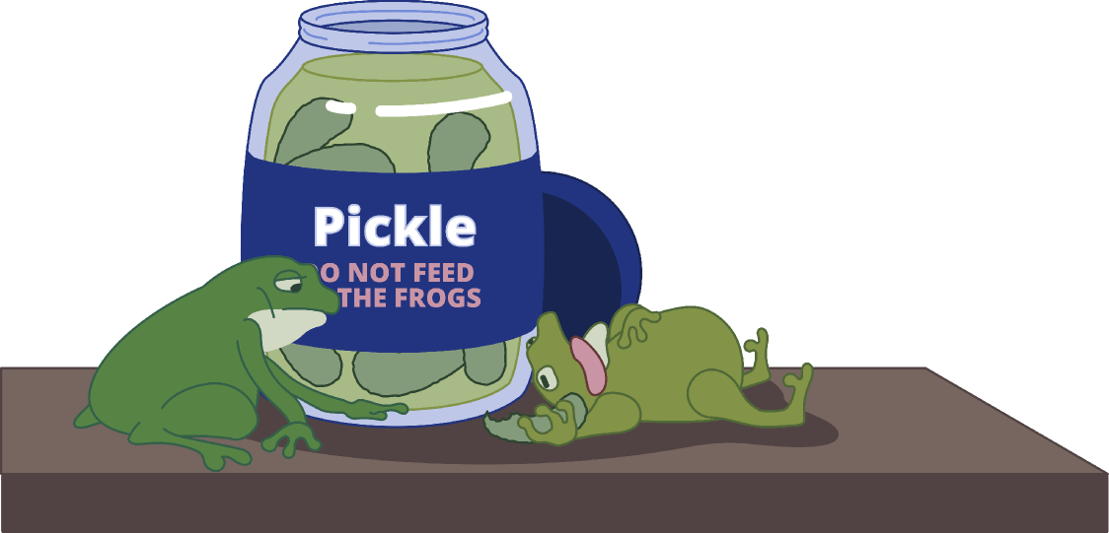

Slide 22

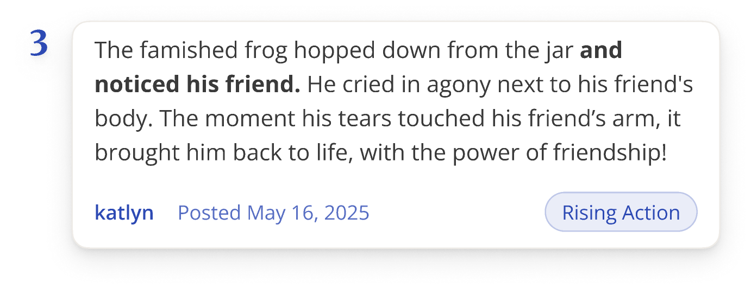
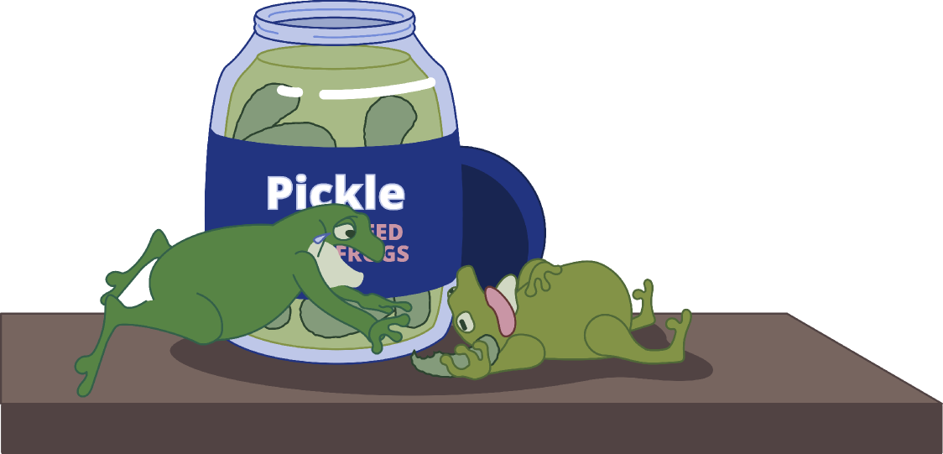

Slide 23

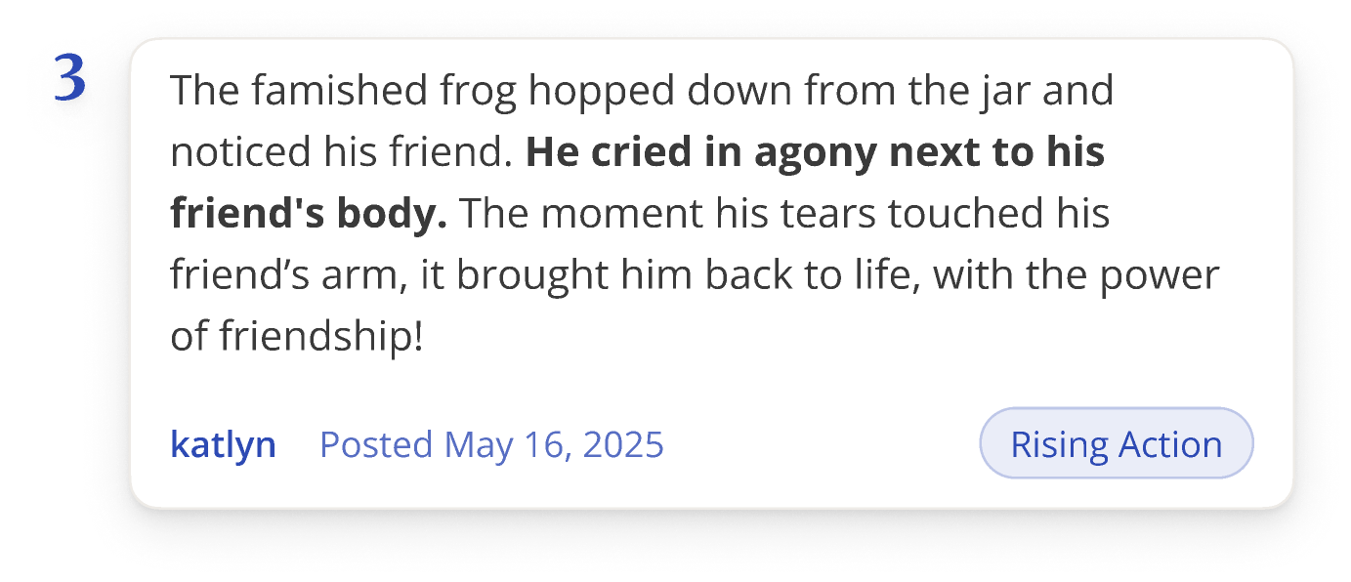
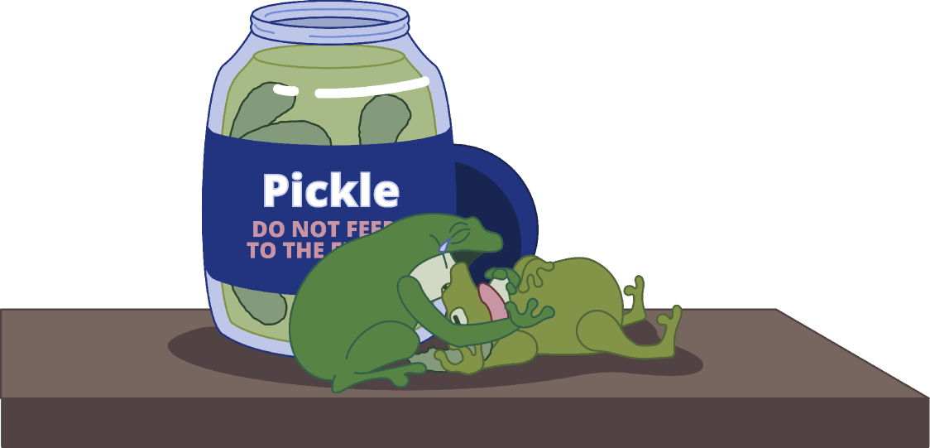

Slide 24

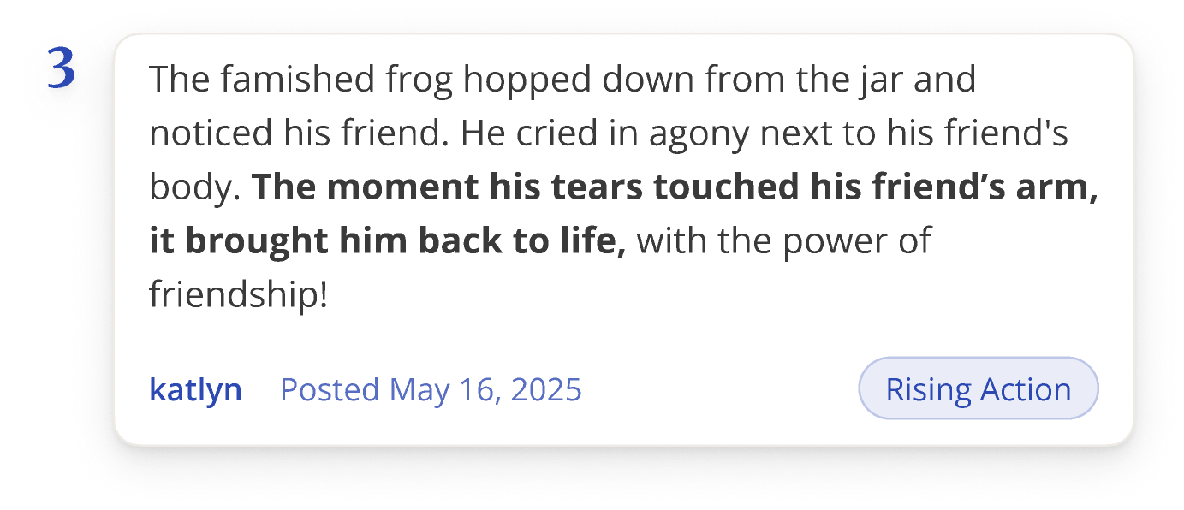


Slide 25




Slide 26




Slide 27



Slide 28




Inklink Features:
Chain-Writing
jamjam
leanna
ubean
katlyn
The Pickle and the Frog
Time Left
It’s your turn to write!
01 : 23 : 59
days
hours
mins
Start Date
Oct. 30, 2025
End Date
Dec. 30, 2025
10 turns until completion...
Pass my turn
Submit writing
To be submitted
6
Tap to start writing...
Recent Submissions
View All

Slide 29


Inklink Features:
Chain-Writing
jamjam
leanna
ubean
katlyn
The Pickle and the Frog
Time Left
It’s your turn to write!
01 : 23 : 59
days
hours
mins
Start Date
Oct. 30, 2025
End Date
Dec. 30, 2025
10 turns until completion...
Pass my turn
Submit writing
To be submitted
6
Tap to start writing...
Recent Submissions
View All

Slide 30



Inklink Features:
Chain-Writing
jamjam
leanna
ubean
katlyn
The Pickle and the Frog
Time Left
It’s your turn to write!
01 : 23 : 59
days
hours
mins
Start Date
Oct. 30, 2025
End Date
Dec. 30, 2025
10 turns until completion...
Pass my turn
Submit writing
To be submitted
6
Tap to start writing...
Recent Submissions
View All

Slide 31




The Pickle and the Frog
The Pickle and the Frog
Inklink Features:
Time Left
It’s your turn to write!
01 : 23 : 59
Private Projects
days
hours
mins
Start Date
Oct. 30, 2025
End Date
Dec. 30, 2025
10 turns until completion...
Pass my turn
Submit writing
To be submitted
6
Tap to start writing...
Recent Submissions
View All

Slide 32






Inklink Features:
Private Projects
Turn 1
Turn 2
Turn 3
Turn 4
Turn 5
leanna
ubean
jamjam
luwucie
katlyn
Writing
Waiting...
Waiting...
Waiting...
Waiting...

Slide 33

Inklink Features:
Private Projects
Turn 1
Turn 2
Turn 3
Turn 4
Turn 5
leanna
ubean
jamjam
luwucie
katlyn
Waiting...
Writing
Waiting...
Waiting...
Waiting...

Slide 34

Inklink Features:
Private Projects
Turn 1
Turn 2
Turn 3
Turn 4
Turn 5
leanna
ubean
jamjam
luwucie
katlyn
Waiting...
Waiting...
Writing
Waiting...
Waiting...

Slide 35

Inklink Features:
Private Projects
Turn 1
Turn 2
Turn 3
Turn 4
Turn 5
leanna
ubean
jamjam
luwucie
katlyn
Waiting...
Waiting...
Waiting...
Writing
Waiting...

Slide 36





Inklink Features:
Private Projects
Turn 1
Turn 2
Turn 3
Turn 4
Turn 5
leanna
ubean
jamjam
luwucie
katlyn
Waiting...
Waiting...
Waiting...
Waiting...
Writing

Slide 37




Inklink Features:
Private Projects
Turn 6
Turn 7
Turn 8
Turn 9
Turn 10
leanna
ubean
jamjam
luwucie
katlyn
Writing
Waiting...
Waiting...
Waiting...
Waiting...

Slide 38


Inklink Features:
Private Projects
Turn 6
Turn 7
Turn 8
Turn 9
Turn 10
leanna
ubean
jamjam
luwucie
katlyn
Writing
Waiting...
Waiting...
Waiting...
Waiting...

Slide 39






Inklink Features:
Private Projects
Turn 6
Turn 7
Turn 8
Turn 9
Turn 10
leanna
ubean
jamjam
luwucie
katlyn
Writing
Waiting...
Waiting...
Waiting...
Waiting...

Slide 40



Have a
tale to tell?

Slide 41












Link the World Through InK

Slide 42






















Learn how to
Ink your Link
by scanning
the QR code!

